Slide 1
WELCOME

Slide 2
Project Overview
Project Name: Analysis of Food and Beverage Industry Survey Data
Objective: The primary objective of this project is to analyze survey responses from the food and beverage industry to gain insights into consumer behavior, preferences, and perceptions. These insights help identify key trends, understand brand perception, and explore potential areas for improvement in product offerings and marketing strategies.
Data Sources: Three datasets used – fact_survey_responses, dim_respondent, and dim_cities.
Mentorness Internship Project
by Saurabh Mane
Batch Name: MIP-DA-13

Slide 3
Data Description
Content:
Fact Table: fact_survey_responses
Contains response-level data such as consume frequency, brand perception, health concerns, and more.
Dimension Table 1: dim_respondent
Contains demographic details of respondents such as age, gender, and respondent ID.
Dimension Table 2: dim_cities
Contains city information, including city tier classification.

Slide 4
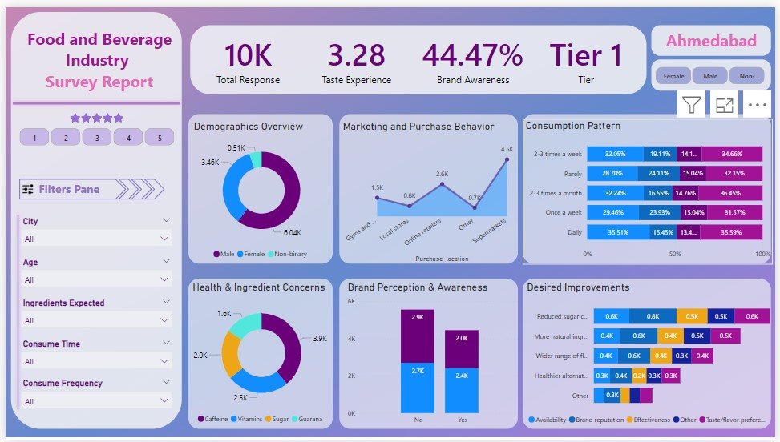
Dashboard Snapshot

Slide 5
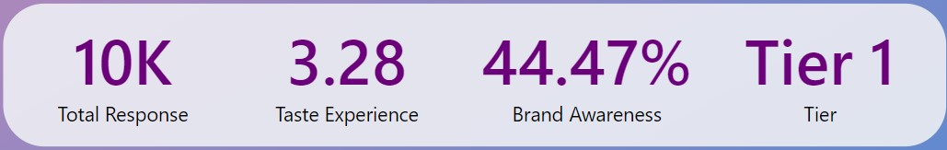
Key Performance Indicators (KPIs)
Content:
Total Responses: 10K responses were analyzed.
Taste Experience: Average taste rating was 3.28/5.
Brand Awareness: 44.47% of respondents were aware of brands in the market.
Tier: Shoes selected City’s Tier Level.
Visual: Snapshot of KPIs section from the dashboard.

Slide 6
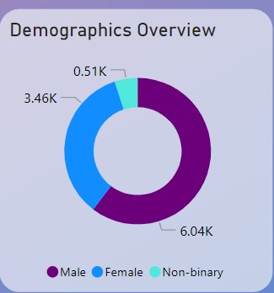
Demographics Overview
Content:
The respondents were split across genders: 51% female, 34.6% male, and 15% non-binary.
Age-wise distribution is not displayed, but it can be filtered on the left pane.
Insights about city-specific demographics, such as Ahmedabad.
Visual: Use the pie chart from the Demographics section.

Slide 7
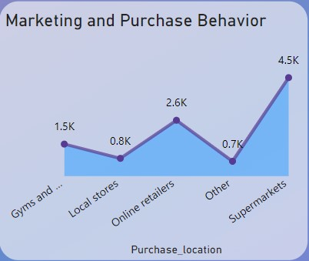
Marketing and Purchase Behavior
Content:
Respondents prefer online retailers (4.5K) and local stores (2.6K) for purchasing food and beverages.
These insights help identify the most effective distribution channels.
Visual: Line chart depicting purchase behavior by location (online, stores, supermarkets).

Slide 8
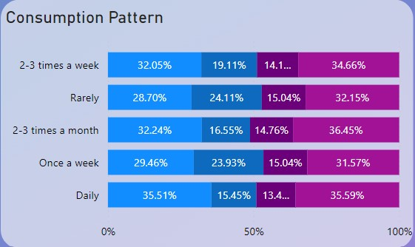
Consumption Patterns
Content:
Majority of respondents consume food and beverages 2-3 times a week.
The most common consumption situations are dinner and daily routines.
Variations in consumption frequency help inform marketing strategies.
Visual: Bar chart showing different consumption frequencies and situations.

Slide 9
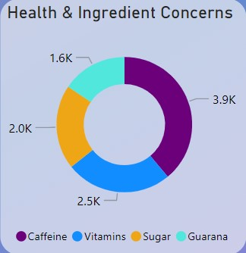
Health and Ingredient Concerns
Content:
Key Concerns: Sugar, caffeine, and vitamins were major health-related ingredients respondents cared about.
Consumers showed interest in healthier and more natural ingredients in their products.
Visual: Donut chart showing health concerns related to ingredients.

Slide 10
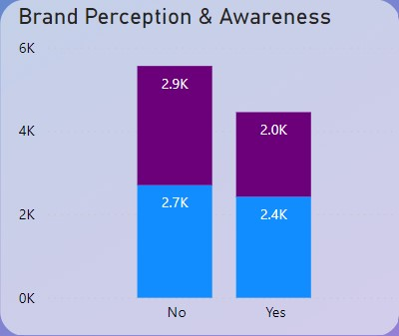
Brand Perception & Awareness
Content:
Around 2.9k of respondents had a positive perception of brands, while 2k were neutral.
This information helps identify gaps in brand reputation and recognition.
Visual: Bar chart on brand perception and awareness.

Slide 11

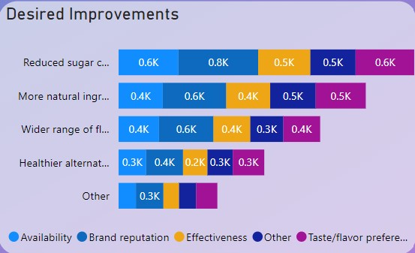
Desired Improvements
Content:
Respondents expressed interest in reduced sugar content (0.5K), more natural ingredients (0.6K), and a wider range of flavors (0.3K).
These insights can help companies focus on product development.
Visual: Bubble chart or bar chart showing various desired improvements.

Slide 12
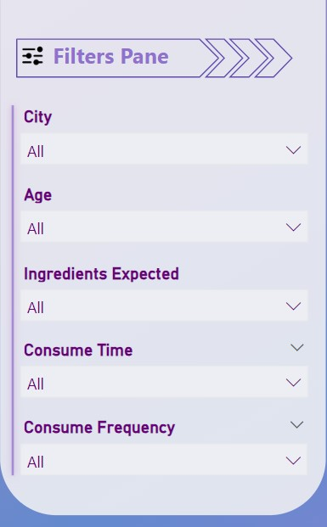
Filters for Deeper Insights
Content:
The dashboard allows users to filter data by city, age, gender, ingredients expected, consumption time, and consumption frequency.
Filters help drill down into specific groups of respondents for targeted insights.
Visual: Highlight the filters pane from your dashboard.

Slide 13
Conclusion and Recommendations
Key Findings:
The majority of respondents consume products frequently and prefer online purchasing.
Health concerns and ingredient preferences are critical to future product development.
Brand awareness is moderate, and there is room to improve perception.
Recommendations:
Focus on health-conscious product innovation.
Invest in online and local store marketing.
Address brand awareness and perception through targeted campaigns.

Slide 14
THANKS!

